Slide 1
Z-scores or Standard Scores

Slide 2
Standard Scores or Z-Scores
What is a z-score?
A measure of an observation’s distance from the mean.
The distance is measured in standard deviation units.
If a z-score is zero, it’s on the mean.
If a z-score is positive, it’s above the mean.
If a z-score is negative, it’s below the mean.
If a z-score is 1, it’s 1 SD above the mean.
If a z-score is –2, it’s 2 SDs below the mean.

Slide 3
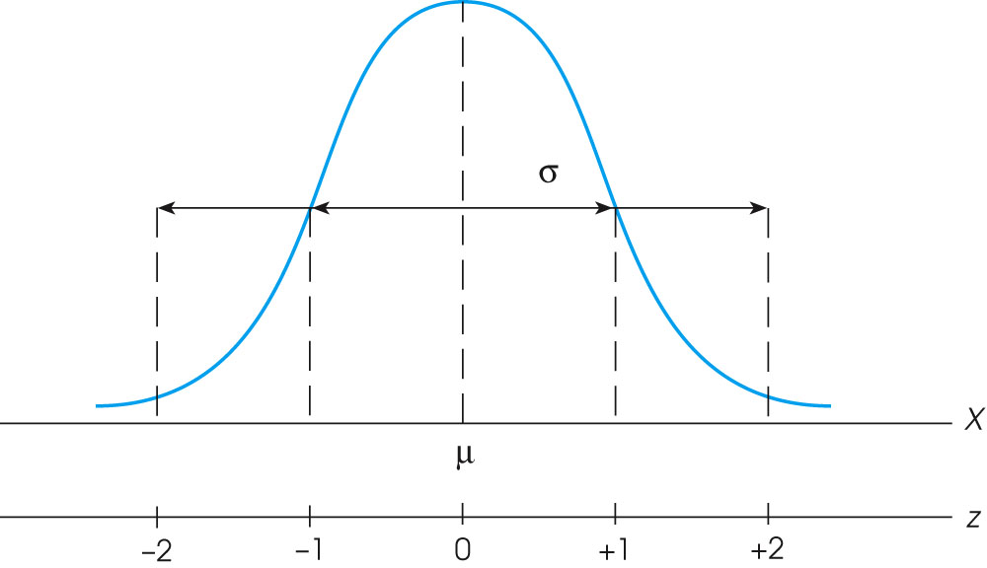
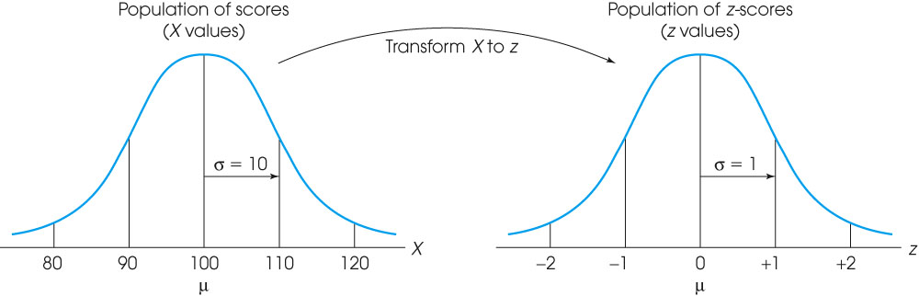
Notes:
Figure 5.3
The relationship between z-score values and locations in a population distribution.
Figure 5.5
An entire population of scores is transformed into z-scores. The transformation does not change the shape of the population, but the mean is transformed into a value of 0 and the standard deviation is transformed to a value of 1.

Slide 4
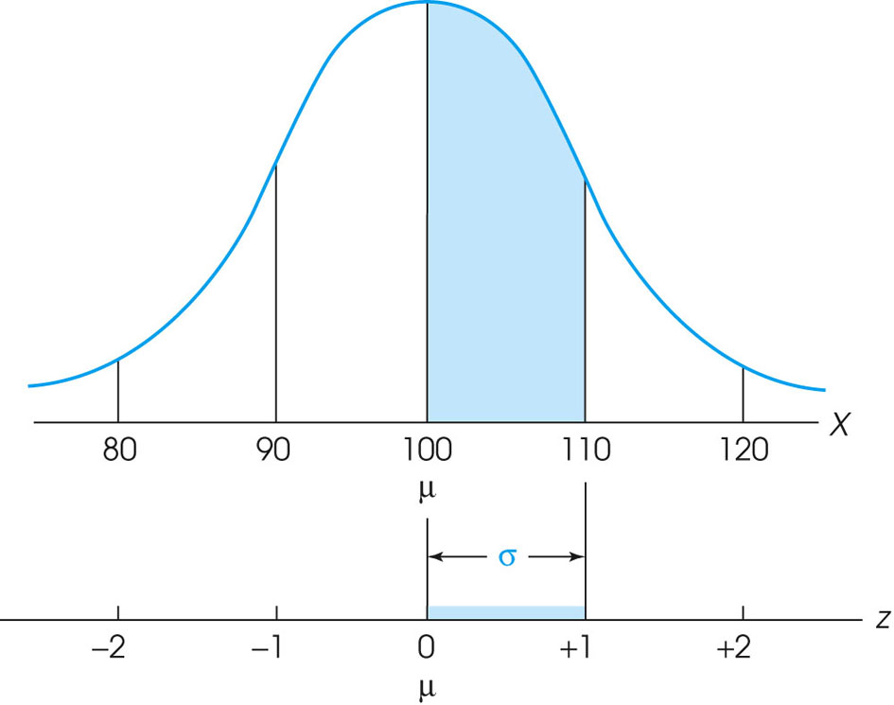
Notes:
Figure 5.6
Following a z-score transformation, the X-axis is relabeled in z-score units. The distance that is equivalent to 1 standard deviation on the X-axis (σ = 10 points in this example) corresponds to 1 point on the z-score scale.

Slide 5
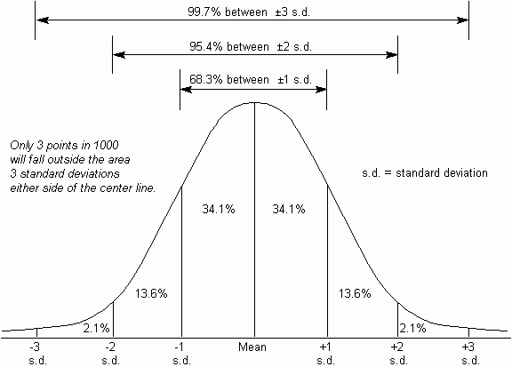

Slide 6
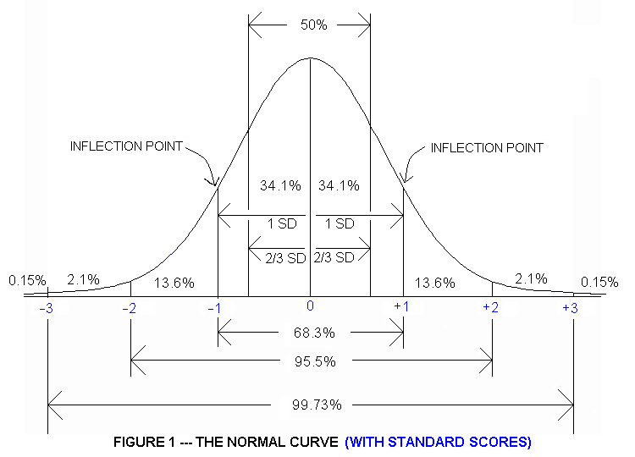

Slide 7
z-Scores and Location
By itself, a raw score or X value provides very little information about how that particular score compares with other values in the distribution.
A score of X = 53, for example, may be a relatively low score, or an average score, or an extremely high score depending on the mean and standard deviation for the distribution from which the score was obtained.
If the raw score is transformed into a z-score, however, the value of the z-score tells exactly where the score is located relative to all the other scores in the distribution.

Slide 8
z-Scores and Location (cont.)
The process of changing an X value into a z-score involves creating a signed number, called a z-score, such that
a. The sign of the z-score (+ or –) identifies whether the X value is located above the mean (positive) or below the mean (negative).
b. The numerical value of the z-score corresponds to the number of standard deviations between X and the mean of the distribution.

Slide 9
z-Scores and Location (cont.)
Thus, a score that is located two standard deviations above the mean will have a z-score of +2.00. And, a z-score of +2.00 always indicates a location above the mean by two standard deviations.

Slide 10
Calculating z-scores
The basic z-score definition is usually sufficient to complete most z-score transformations. However, the definition can be written in mathematical notation to create a formula for computing the z-score for any value of X.
X – μ
z = ────
σ

Slide 11
Example 1
Ben is a 4th grader in an underperforming school
In one case, Ben’s math exam score is 10 points above the mean in his school
BUT, Ben’s exam score is 10 points below the mean for students in his grade in the country
It is useful to interpret Ben’s performance relative to average performance.
Ben’s class
Ben’s class
Ben’s class
Ben’s grade across the country
Ben’s grade across the country
Mean of class = 40
Mean of students across country = 60
Mean of class = 40

Slide 12
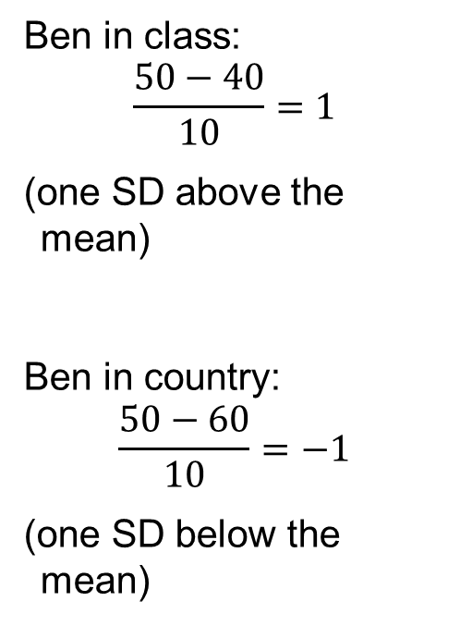
Example 1
Ben’s class
Ben’s grade across the country
Mean of class = 40
Mean of students across country = 60

Slide 13
Example 2 – Dave is a Math Concentrator
Both distributions have the same mean (40), but different standard deviations (5 vs. 20)
In one case, Dave is performing better than almost 95% of the class. In the other, he is performing better than approximately 68% of the class.
Thus, how we evaluate Dave’s performance depends on how much variability there is in the exam scores
Dave got 50 on both exams
Statistics
Calculus

Slide 14
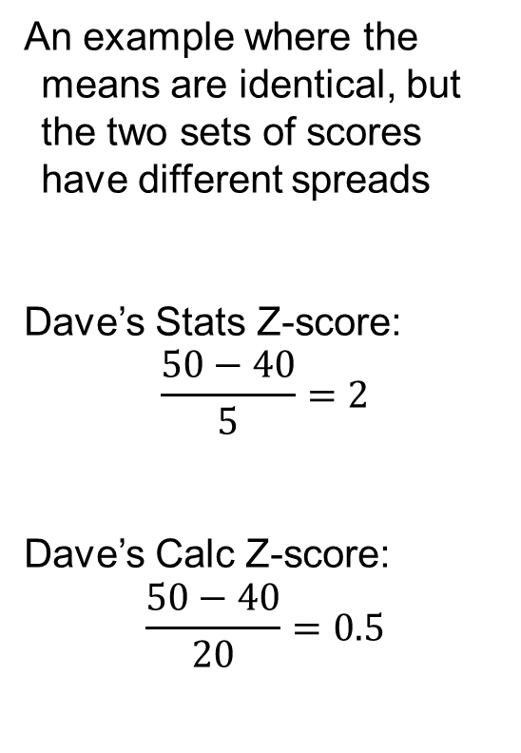
Example 2
Statistics
Calculus

Slide 15
Why is the Mean of z-scores always equal to 0?
M = 50
BUT what is the mean of the deviation scores?
Look back in your notes.
x
20
30
40
50
60
70
80
z
-3
-2
-1
0
1
2
3

Slide 16
z-Scores as a Standardized Distribution
When an entire distribution of X values is transformed into z-scores
The resulting distribution of z-scores will always have a mean of zero and a standard deviation of one.
The transformation does not change the shape of the original distribution and it does not change the location of any individual score relative to others in the distribution.

Slide 17
z-Scores as a Standardized Distribution (cont.)
The advantage of standardizing distributions is that two (or more) different distributions can be made the same.
For example, one distribution has μ = 100 and σ = 10, and another distribution has μ = 40 and σ = 6.
When these distribution are transformed to z-scores, both will have μ = 0 and σ = 1.

Slide 18
z-Scores as a Standardized Distribution (cont.)
Because z-score distributions all have the same mean and standard deviation, individual scores from different distributions can be directly compared.
A z-score of +1.00 specifies the same location in all z-score distributions.

Slide 19
Read Pages 223-224 Complete Ex 13A Note: The textbook calls z-scores standard scores.

